Slide 1
Pure Maths Summary

Slide 2
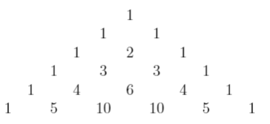
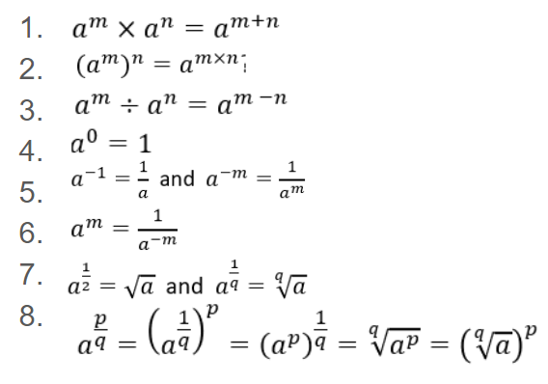
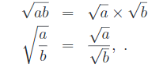
Summary of topics
Week 1 Numbers
Positive and negative numbers
Proper in improper fractions
Equivalent Fractions
BODMAS (Bracket, pOwers, Division, Multiply, Add, Subtract)
Rounding
Percentages and ratios
Surds
Week 2&3 Algebra
Laws of indices
Week 2&3 Algebra
Pascal’s Triangle

Slide 3
Summary of topics
Week 1 Numbers
Positive and negative numbers
Proper in improper fractions
Equivalent Fractions
BODMAS (Bracket, pOwers, Division, Multiply, Add, Subtract)
Rounding
Percentages and ratios
Surds
Week 2&3 Algebra
Laws of indices

